Slide 1
Introduction to Programming Language II(Java)
Fariha Zahin
Lecturer
CSE, Southeast University

Slide 2
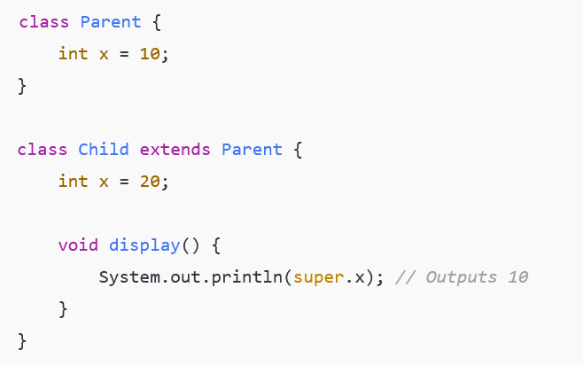
super keyword:
It is used to refer to the immediate parent class object.
Helps access:
Parent class constructor
Parent class methods
Parent class data members
Using super to Access Parent Class Variables
In this code, the Child class has a variable x that hides the x variable from its Parent class. Inside the display method of Child, super.x is used to access the x from the parent class (value 10), rather than the one in the child class (value 20). This shows how super can resolve variable name conflicts in inheritance.

Slide 3
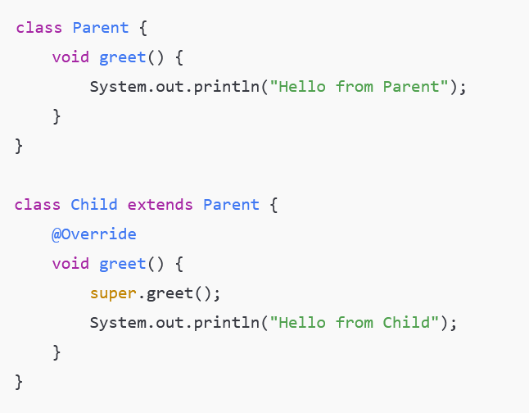
Using super to Call Parent Class Method
The Child class overrides the greet method of the Parent class. Inside the child’s version of greet, super.greet is used to call the original method from the parent before printing its own message. This demonstrates how to invoke a superclass method when it is overridden in the subclass.

Slide 4
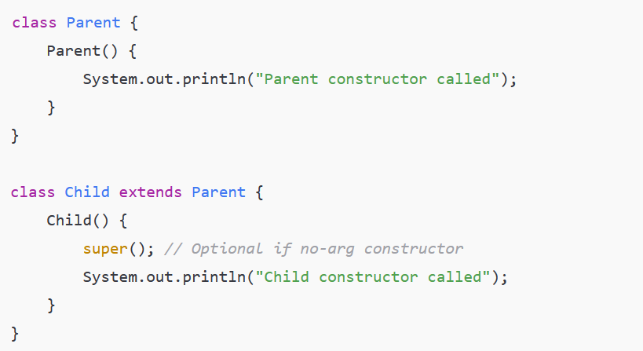
Using super to Call Parent Constructor
super() must be the first statement in a constructor if used.
Here, the Child class constructor explicitly calls the no-argument constructor of the Parent class using super. This ensures the parent constructor runs first before executing the child constructor’s code. It illustrates how constructor chaining works between parent and child classes in Java.

Slide 5
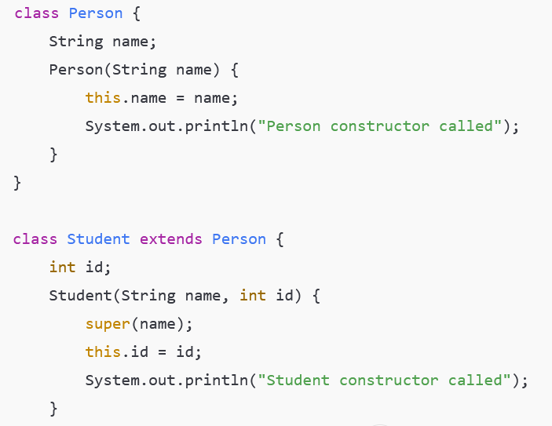
In this example, the Student class extends Person, and both have constructors that accept parameters. The Student constructor uses super to call the Person constructor and initialize the inherited name field. The main method creates a Student object, showing how both constructors are executed and how values are initialized through inheritance.

Slide 6
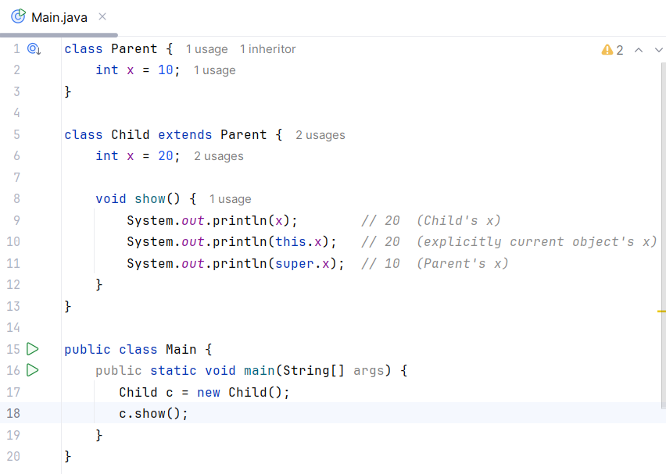

super vs this
super → refers to the immediate parent class object
this → refers to the current object
They can be used together when necessary.

Slide 7
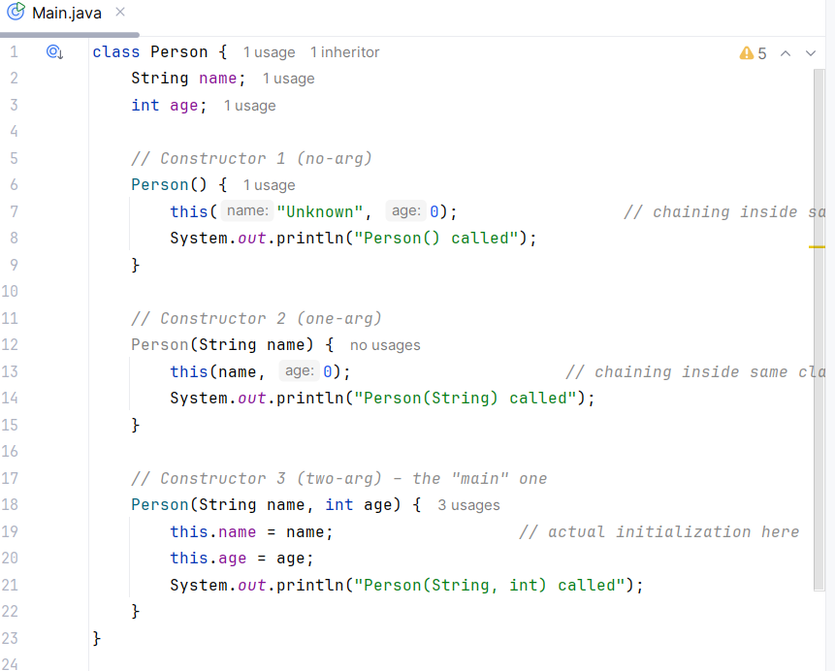
Constructor Chaining
When constructors call other constructors (in the same class or in the parent class) to avoid code duplication and ensure proper initialization.
Two ways:
this(...) → calls another constructor in the same class
super(...) → calls a constructor in the immediate parent class

Slide 8
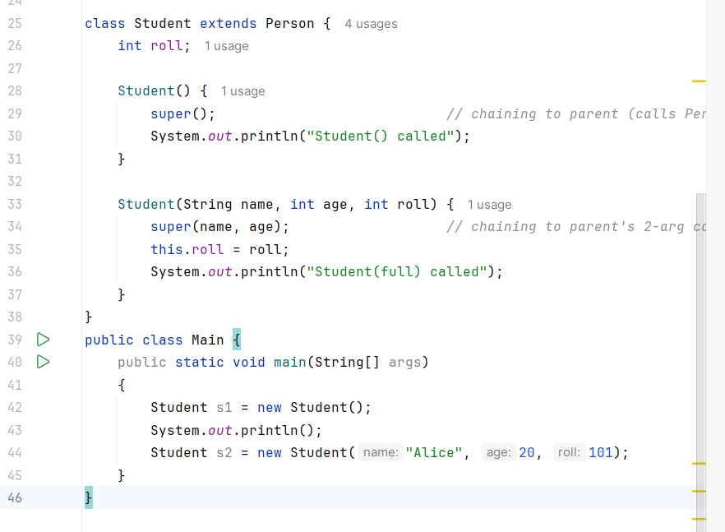
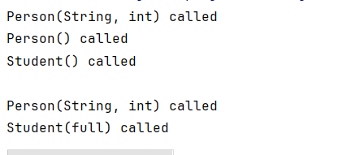
Constructor Chaining
Rules:
this(...) or super(...) must be the first statement in a constructor.
Only one of them can be used (not both).
If you write nothing → compiler automatically inserts super() (no-arg parent constructor).

Slide 9
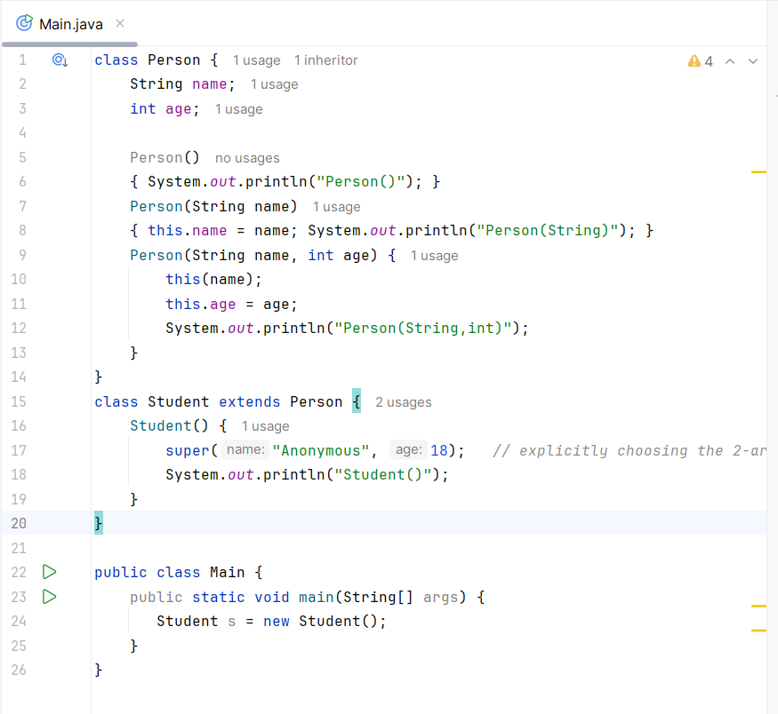
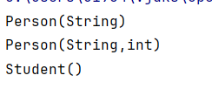
Calling Overloaded Parent Constructors

Slide 10
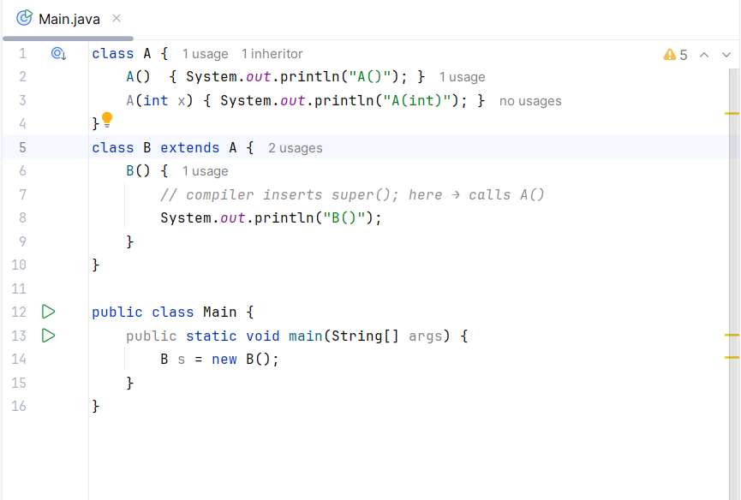
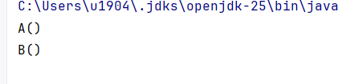
super() is inserted automatically (only for no-arg)

Slide 11
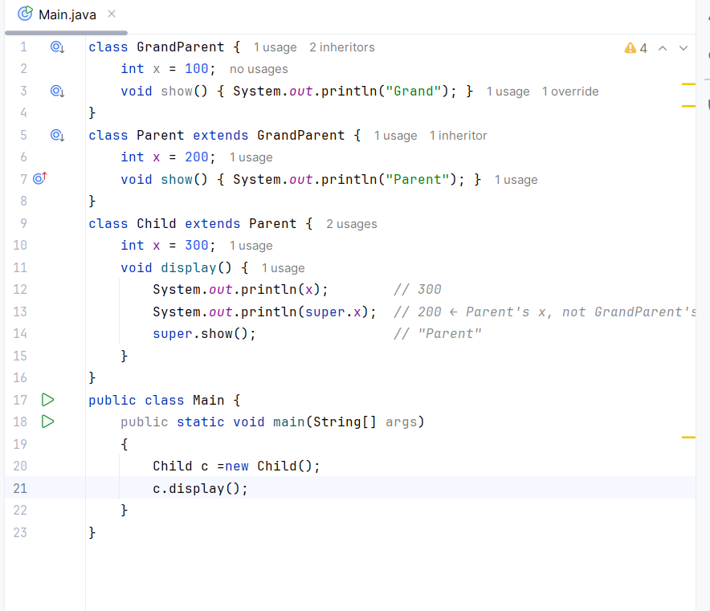
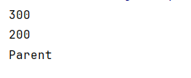
super() only calls immediate parent

